Slide 1
Benchmarking-Node2Vec and Deepwalk
Nilaksh agarwal
Nihar Modi

Slide 2
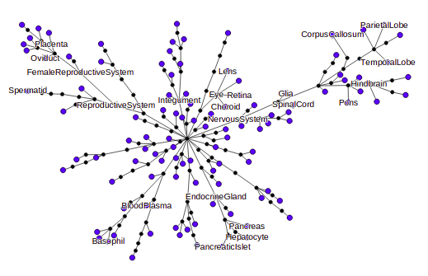
PPI
It is a human protein-protein interaction (PPI) network, tissue-specific network layers, tissue hierarchy, and tissue-specific gene-function relationships. They took the latest protein, tissue, and function information from various reputable public data sources.
For example, they represented similarities between tissues with a hierarchy defined over 219 tissues (e.g., muscle, adrenal cortex, bone marrow), pictured here. We then constructed a multi-layer network with 107 layers, each representing one tissue-specific protein interaction network, shown as a blue leaf in this picture.

Slide 3
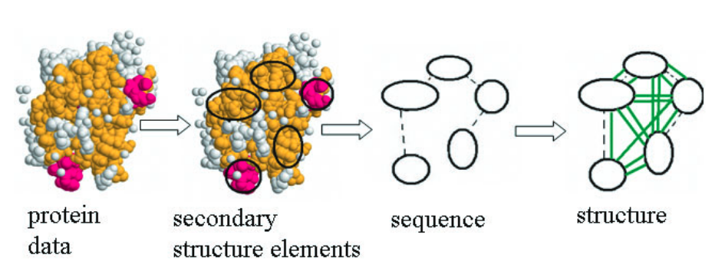
Protein
Computational approaches to protein function prediction infer protein function by finding proteins with similar sequence, structure, surface clefts, chemical properties,amino acid motifs, interaction partners or phylogenetic pro-files. We present a new approach that combines sequential,structural and chemical information into one graph model of proteins. We predict functional class membership of enzymes and non-enzymes using graph kernels and support vector machine classification on these protein graphs.

Slide 4

Brightkite
Brightkite was once a location-based social networking service provider where users shared their locations by checking-in. The friendship network was collected using their public API, and consists of 58,228 nodes and 214,078 edges. The network is originally directed but we have constructed a network with undirected edges when there is a friendship in both ways. We have also collected a total of 4,491,143 check ins of these users over the period of Apr. 2008 - Oct. 2010

Slide 5
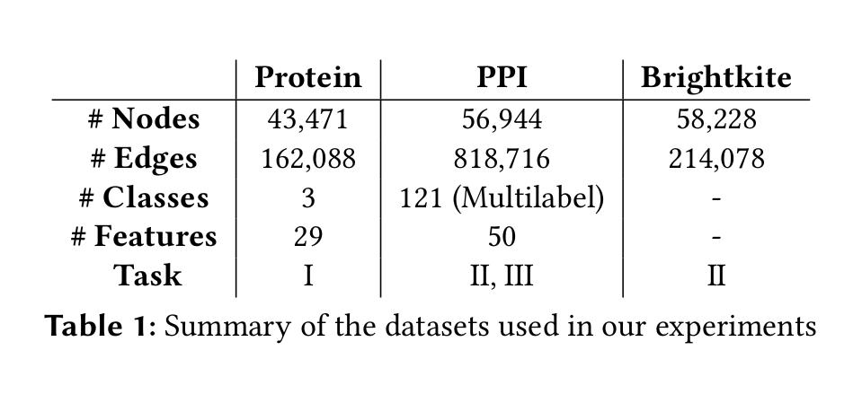
Datasets detail

Slide 6
Prediction tasks
Pairwise node classification -
Given two nodes, predict if they belong to the same class
Link Prediction -
To predict if there is an edge between two nodes
Multi-class node classification -
To predict the class labels for a given node

Slide 7
Scoring Methods
ROC AUC - It tells how much model is capable of distinguishing between classes
Precision- It is the ratio TP / (TP + FP)
Recall - It is the ratio TP / (TP + FN)
F1 score -It is the harmonic mean of Precision and Recall

Slide 8
Node2Vec
The node2vec framework learns low-dimensional representations
for nodes in a graph by optimizing a neighborhood preserving ob-
jective.
The objective is flexible, and the algorithm accommodates
for various definitions of network neighborhoods by simulating
biased random walks.

Slide 9
Deepwalk
The method used to make predictions is skip-gram, just like in
Word2vec architecture for text. Instead of running along the text
corpus, it runs along the graph to learn an embedding.
Although DeepWalk is relatively efficient with a score of O (|V |),
this approach is transductive.

Slide 10
Differences
Node2vec features a walk bias variable α, which is parameter-
ized by p and q which prioritizes BFS and DFS respectively.
Experiments demonstrated that BFS is better at classifying according to structural roles (hubs, bridges, outliers, etc.) while DFS returns a more community driven classification scheme.
Node2vec can switch to and from the two priorities depending on the task.

Slide 11
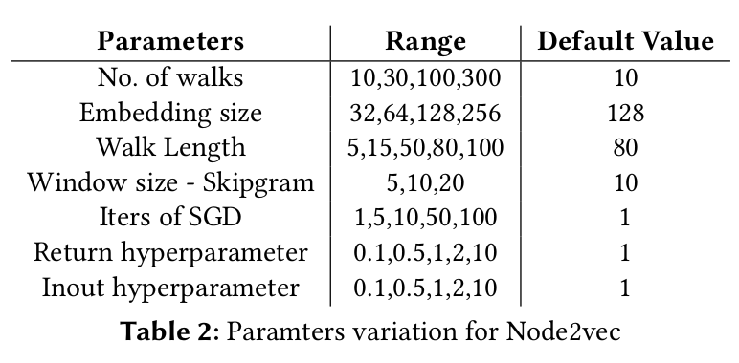
Parameter variation

Slide 12
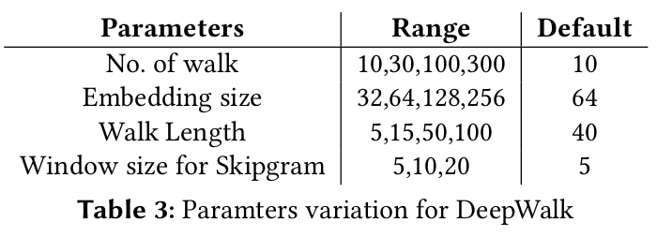
Parameter variation

Slide 13
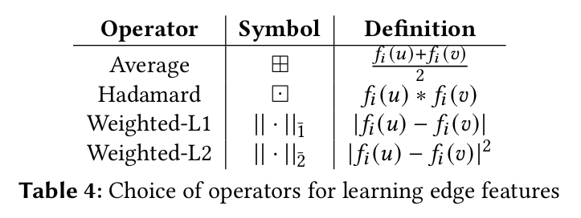
Aggregator functions

Slide 14
Pair-wise node classification
Node2vec outperforms Deepwalk, and they both outperform other
networks such as GCN, GraphSAGE, GAT, GIN etc.
However, this may be due to these networks performing this task
in the inductive setting whereas Node2vec and Deepwalk use the
transductive setting.

Slide 15
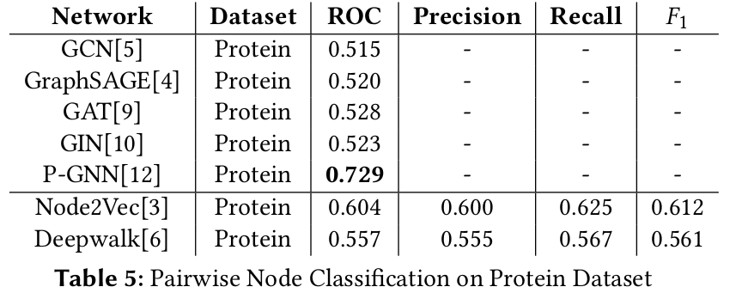

Slide 16
Link Prediction
Node2vec outperforms Deepwalk, however they are both beaten by
other networks such as GCN, GraphSAGE, GAT, GIN, P-GNN etc.
This may be due to the fact that Node2vec and DeepWalk don’t
use any node features during their training, and rely only on the
neighbourhood of the node

Slide 17
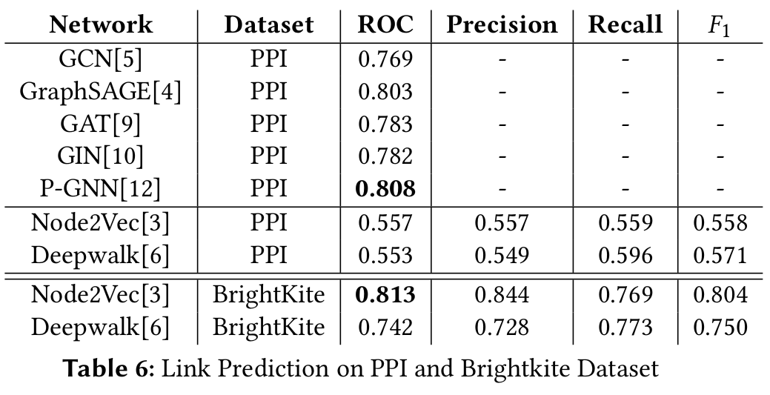

Slide 18
Multi-Label Node Classification
Node2vec outperforms Deepwalk, however they are both beaten
by other networks such as GraphSAGE, GAT etc.
Since PPI has over 121 distinct labels per node, it is difficult to
predict each and every one of them accurately with only the neigh-
bourhood information of the node

Slide 19
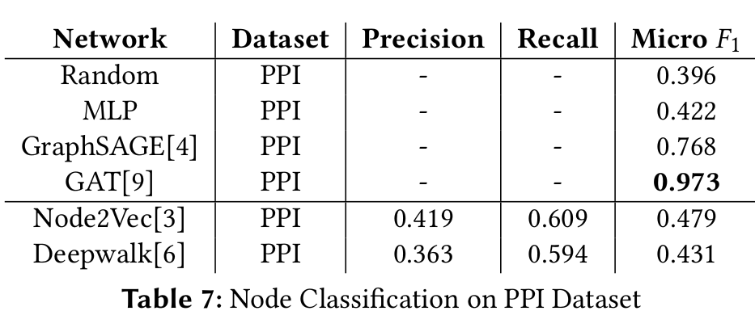

Slide 20
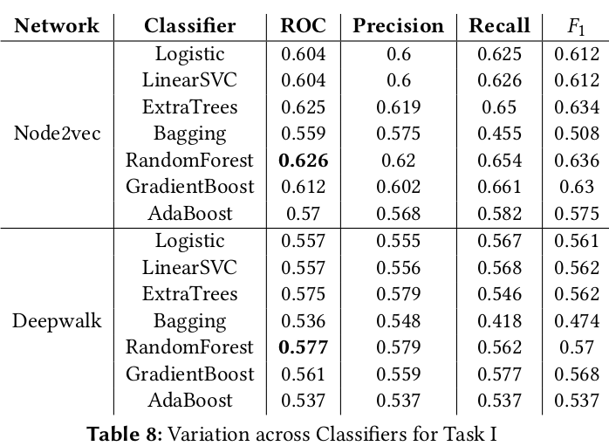
Classifiers
Random-Forests with 100 trees gives us the best results
for both methods

Slide 21
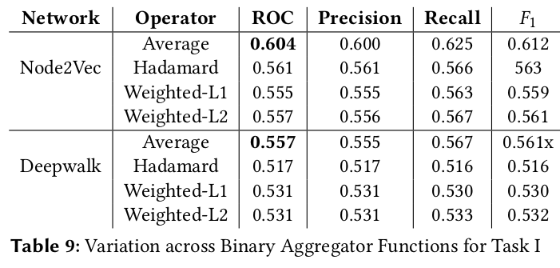
Aggregator functions
The Average binary operator performs the best
The Hadamard operator
suppresses a dimension even if one operand is zero in the same
The L1 and L2 values capture only the relative distance between
the operands

Slide 22
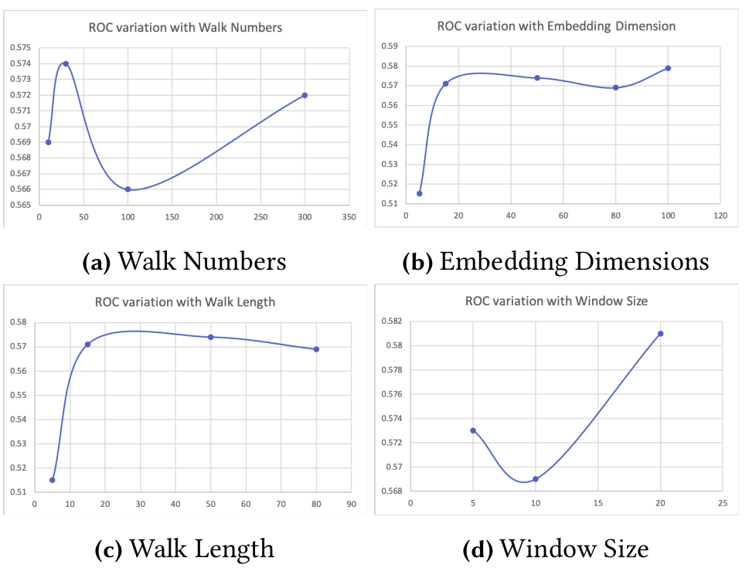
Parameter variation analysis (Node2vec)

Slide 23
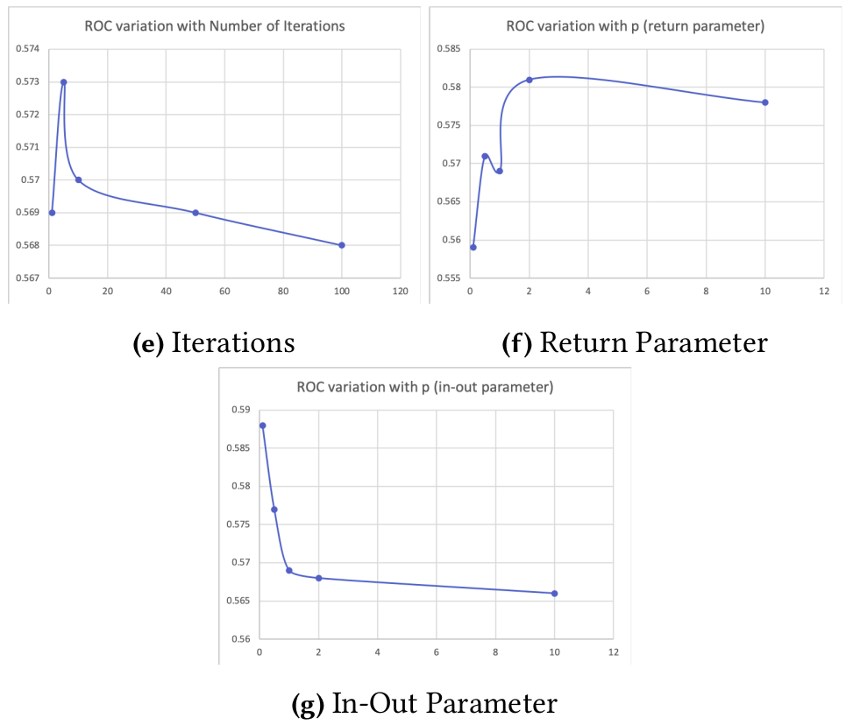
Parameter variation analysis (Node2vec)

Slide 24
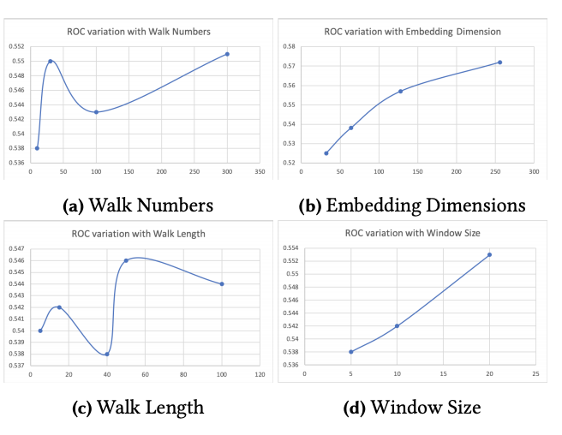
Parameter variation analysis (DeepWalk)

